Slide 1

Philippine’s High Frequency Model
Julián Pérez García
Full Professor Universidad Autónoma de Madrid
Director Instituto “L.R.Klein”
General Director CEPREDE
ANGELO KING INSTITUTE FOR ECONOMIC AND BUSINESS STUDIES (DLSU-AKI)
March 8^{th.}

Slide 2
General approach
DESCRIPTION:
The methodology proposed for the (Philippine's High Frequency Model) PHFM is based on the high-frequency models proposed by Klein y Sojo (1989) which was originally based on Principal Components technique, that we further extend to Dynamic Factor Analysis.
The PC technique are founded on the idea that given a set of variables highly correlated with a reference variable, it can be constructed a set of indicators that are uncorrelated linear combinations of the original set of variables and that can explain the total variation of it.
In this way, we can use the principal components (factors) as explanatory variables of the reference indicator (i.e. macroeconomic aggregates)
Once we have computed the factors and given that the object of study is not only to obtain a monthly series of the aggregate, but also to forecast it, we will also need to compute forecasts for these factors obtained in the previous stage. To this end, forecasting techniques based on autoregressive ARIMA-type models will be used, which will allow us to obtain a reliable prediction of the factors obtained.
Klein L.R. y E. Sojo, (1989). “Combination of High and Low Frequency Data in Macroeconometric Models” in L.R. Klein and J. Marquez (eds.), Economics in Theory and Practice: An Eclectic Approach
Box, G.E.P. y Jenkins, G.M. (1970): "Time Series Analysis, Forecasting and Control". Holden Day. San Francisco.

Slide 3
General approach
DESCRIPTION:
Thus, once the factors and their (monthly) forecasts have been estimated, together with the quarterly aggregates, we can obtain a monthly indicator for each one of the components, including short term forecast, by applicating of Chow-Lin (1971) type temporal disaggregation techniques.
Additionally, and given that the model is going to be applied to the both, aggregate Supply and Demand, sides of the GDP, the final congruent forecasts are obtained by applying a congruence procedure (benchmarking) based on the proposals of Di Fonzo and Marini (2003).
As an additional output, further away from the main object of study (forecasting GDP and main components), once the prediction of the factors has been made, we can reverse the process, to obtain joint and consistent forecast of the original set of indicators selected for the study.
Chow, G.C. y A. Lin (1971) “Best Linear Unbiased Interpolation, Distribution, and Extrapolation of Time Series by Related Series”, The Review of Economics and Statistics, vol. 53, n. 4, p. 372-375.
Di Fonzo T. y Marini, M. (2003): “Benchmarking systems of seasonally adjusted time series according to Denton’s movement preservation principle” Working Paper.Dipartamento di Science Statistiche. Universita degli studi de Padova.

Slide 4
General approach
1
Selection of the set of monthly available indicators.
2
Group the set of indicators for each aggregated, including lags, and extracting the principal components for each group.
3
Forecast the main factors in each group (eigenvalues higher than 1) using ARIMA techniques.
6
4
Obtaining the initial monthly indicators for each of the aggregates by means of Chow-Lin type temporal disaggregation procedures.
5
Estimation of the total aggregate of GDP using congruence procedures with longitudinal and transversal constraints (benchmarking) such as Di Fonzo and Marini.
Obtaining the forecasts of each one of the specific indicators through ARMAX-type procedures using the factors as exogenous variables of the specific models of each indicator.

Slide 5
General approach
GENERAL STRUCTURE OF THE MODEL
Quarterly
Aggregates
PSA
Principal Components
Chow-Lin Disaggregation procedure
Set of Monthly
Indicators
Monthly
Factors
Supply
Demand
Monthly
Aggregates
and forecasts
ARIMA Models
Forecast
Forecasts
Forecasts
Forecasts
Benchmarking
Di Fonzo y Marini
ARMAX Models

Slide 6
Methodology
PRINCIPAL COMPONENTS
Principal components is a quantitative tool, which postulates that a set of n series Yt can be expressed as a function of a set of factors Ft, orthogonal to each other, that collect the totality of the joint variance of the original series, in such a way that the first and successive factors collect as much of the joint variance as possible.
Dynamic extension consists of the extension of the initial set of variables to be analyzed with their successive lags i, in such a way that the common factors also include the possible discrepancies between the different series (leading and lagging indicators).
The unobservable factors Ft are obtained by applying the Principal Components procedure to the set of observable variables Zt.

Slide 7
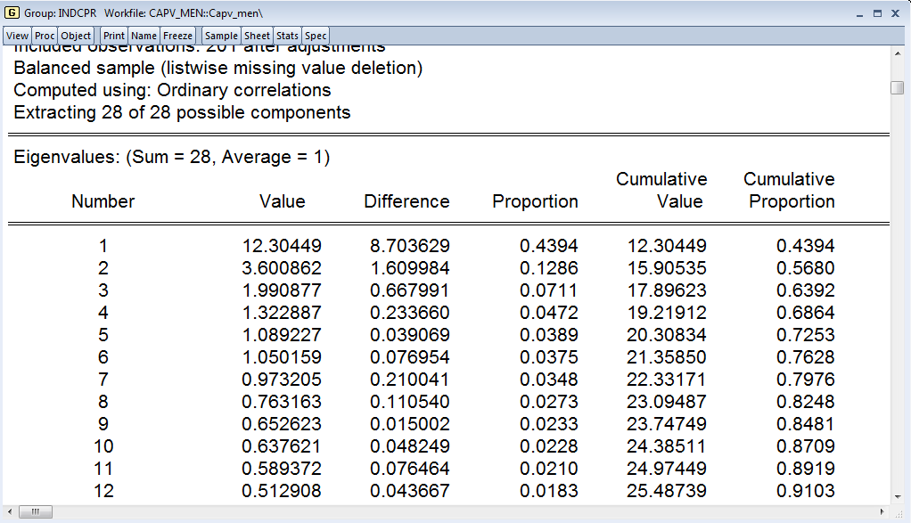
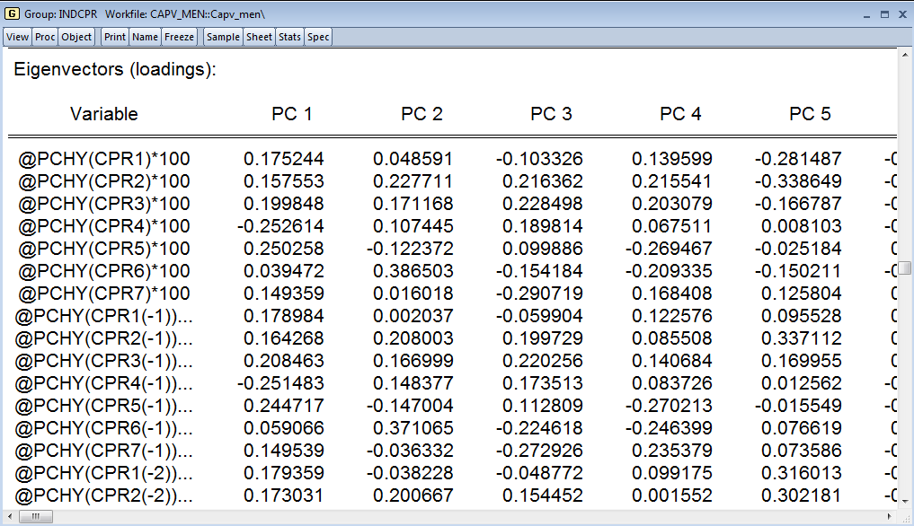
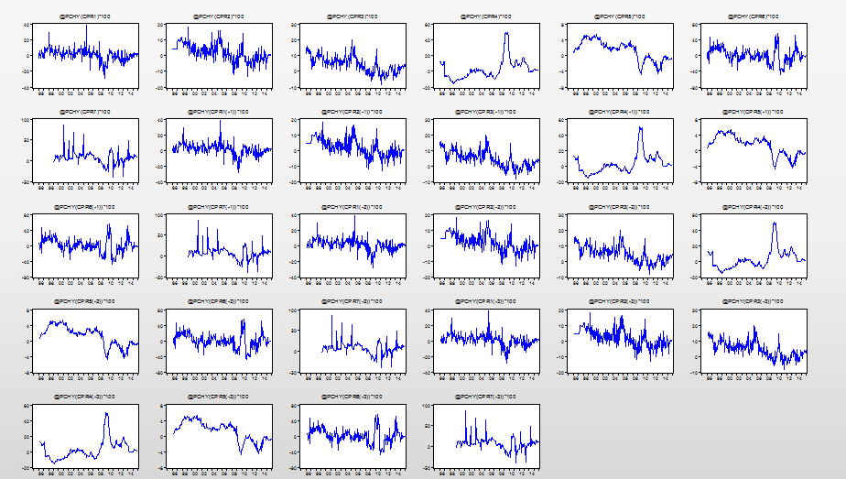
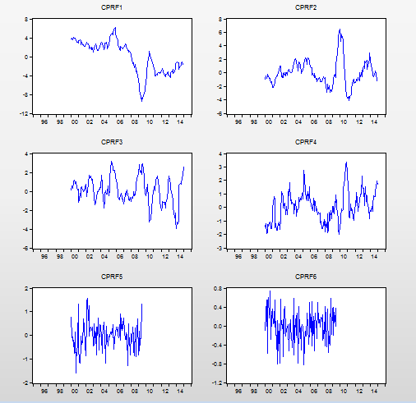
Methodology
PRINCIPAL COMPONENTS
Generally, the factors obtained in this way present a distribution of the total variance explained that decreases exponentially, and it is usual to select as relevant those factors that present eigenvalues greater than unity.

Slide 8
Methodology
ARIMA /ARMAX MODELS
ARIMA models respond to the acronym of AutoRegressive, Integrated, and Moving Average processes, and were initially proposed by George Box and Gwilym Jenkins in 1970.
Main underlying hypothesis is to admit that any time series are generated by a Data Generating Process that can be identified and quantified and, therefore, they can be used to reproduce data and to generate forecasts. In this way, any time series can be represented by a combination of known processes (AR I MA).
The ARMAX extension, or its traditional specification as Transfer Functions, also supports the incorporation of exogenous variables that explain the X_{i,t} process.
In this way, once the coefficients have been estimated and the future values of the exogenous X_{i,t+s} are known, the values of the variables of interest Y_{t+s} can be projected.

Slide 9
Methodology
TEMPORAL DISAGGREGATION. CHOW-LIN Approach.
Temporal disaggregation methods aim to obtain a variable at a higher frequency than the original that satisfies the longitudinal aggregation constraint.
In 1971, Chow and Lin proposed a method of temporal disaggregation based on the availability of one or more "proxis" variables X_{km,t} (indicators) measured at high frequency and highly correlated with the variable of interest Y_{q,t}
The implementation of the model is based on the estimation of a low-frequency regression between the variable to be disaggregated and the indicators.
Initial values are then obtained at high frequency by applying the estimated coefficients to the values of the “proxi” variables.

Slide 10

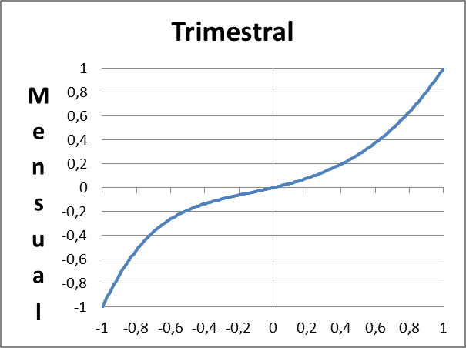
Methodology
TEMPORAL DISAGGREGATION. CHOW-LIN Approach.
Compliance of the longitudinal, or aggregation constraint, is ensured by adding to the initial high-frequency series the low-frequency regression errors distributed as a function of the structure of the random perturbation of the model.
Chow and Lin propose a high-frequency model that follows an AR(1) process, so that their Variances and covariances matrix will be:
Di Fonzo y Filosa(1987) derivates the relationship between high and low frequency autocorrelation coefficients
Di Fonzo, T., & Filosa, R. (1987). Methods of estimation of quarterly national account series: a comparison. Journée franco-italienne de Compatibilité Nationale.

Slide 11
Methodology
SERIES RECONCILIATION (BENCHMARKING).
The problem of series reconciliation or benchmarking arises when we want to disaggregate a set of s series Y_{sq,t} that must also comply with a cross-sectional constraint between them. E.g
In 2003, Di Fonzo and Marini proposed a method that allows the reconciliation of sets of series that must comply with both the longitudinal (aggregation) and transversal constraints. Where:

Slide 12


Practical implementation
In our experience, the best way to develop and update this kind of models is combining excel files for database and reporting and Eviews workfile and batch files (programs) to process the information.
For our model developed for the Basque Country, that can be used as a template, we have one excel file with both, historical data base and reporting (PHFM.XLSX), two Eviews workfiles, Monthly.wf1 and Quarterly,wf1, and two Eviews batch files (programs) Update_estimate.prg and Temp_disagre.prg
Monthly.wf1
Quarterly.wf1
PHFM.XLSX
Update_
estimate.prg
Temp_
disagre.prg
Forecasting
output.xls

Slide 13
Thank you very much for your attention
Further information:
www.ceprede.es
Contact at:
julian.perez@ceprede.es
julian.perez@uam.es

